Slide 1
Algorithm types

Slide 2
algorithm
An algorithm is a step-by-step procedure to solve a problem.
It is a logical and mathematical approach to solve or crack a problem using any possible method.
A good algorithm should be optimized in terms of time and space.
Different types of problems require different types of algorithmic-techniques to be solved in the most optimized manner.

Slide 3
Types of algorithm
Recursive algorithms
Dynamic programming algorithm
Backtracking algorithm
Divide and conquer algorithm
Greedy algorithm
Brute Force algorithm
Randomized algorithm
Branch and bound algorithm

Slide 4
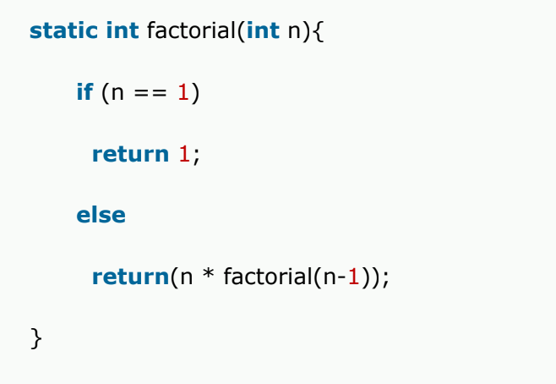
Simple recursive algorithm
Solves the base case directly and then recurs with a simpler or easier input every time (A base value is set at the starting for which the algorithm terminates).
It is used to solve the problems which can be broken into simpler or smaller problems of same type.

Slide 5
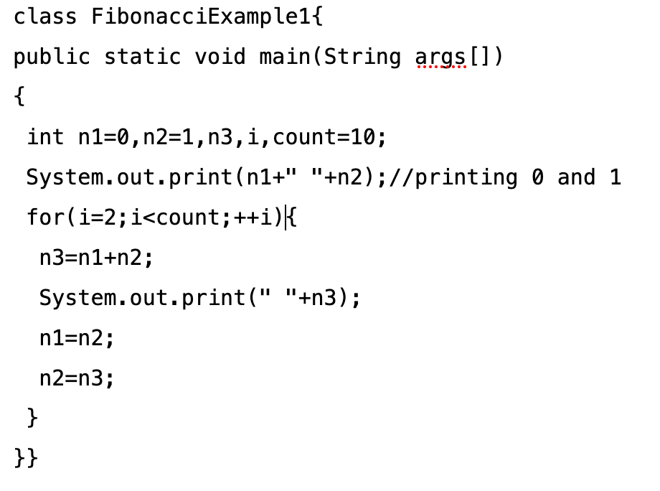
Dynamic programming algorithm
A dynamic programming algorithm remembers the past result and uses them to find new result
it solve complex problems by breaking it down into a collection of simpler subproblems, then solving each of those subproblems only once, and storing their solution for future use instead of recomputing their solutions again.

Slide 6
Backtracking algorithm
Backtracking is an algorithmic-technique for solving problems recursively by trying to build a solution incrementally, one piece at a time, removing those solutions that fail to satisfy the constraints of the problem at any point of time
For example, consider the SudoKo solving Problem, we try filling digits one by one. Whenever we find that current digit cannot lead to a solution, we remove it (backtrack) and try next digit.
Solving SudoKo Algorithm https://www.geeksforgeeks.org/sudoku-backtracking-7/

Slide 7
Divide and conquer algorithm
In Divide and Conquer algorithms, the idea is to solve the problem in two sections, the first section divides the problem into subproblems of the same type. The second section is to solve the smaller problem independently and then add the combined result to produce the final answer to the problem.
Some common problem that is solved using Divide and Conquers Algorithms are Binary Search, Merge Sort, Quick Sort

Slide 8
Greedy algorithm
Greedy algorithm is an algorithm that solves the problem by taking optimal solution at the local level (without regards for any consequences) with the hope of finding optimal solution at the global level.
Greedy algorithm is used to find the optimal solution, but it is not necessary that you will find the optimal solution by following this algorithm.

Slide 9
Brute force algorithm
A brute force algorithm simply tries all the possibilities until a satisfactory solution is found.
Such types of algorithm are also used to find the optimal (best) solution as it checks all the possible solutions.
And also used for finding a satisfactory solution (not the best), simply stop as soon as a solution of the problem is found.
For Example: If there is a lock of 4-digit PIN. The digits to be chosen from 0-9 then the brute force will be trying all possible combinations one by one like 0001, 0002, 0003, 0004, and so on until we get the right PIN. In the worst case, it will take 10,000 tries to find the right combination.

Slide 10
Randomized algorithm
A randomized algorithm uses a random number at least once during the computation to make a decision.
A randomized algorithm is a technique that uses a source of randomness as part of its logic.
This kind of algorithm could help speed up a brute force process by randomly sampling the input in order to obtain a solution that may not be totally optimal, but will be good enough for the specified purposes.

Slide 11
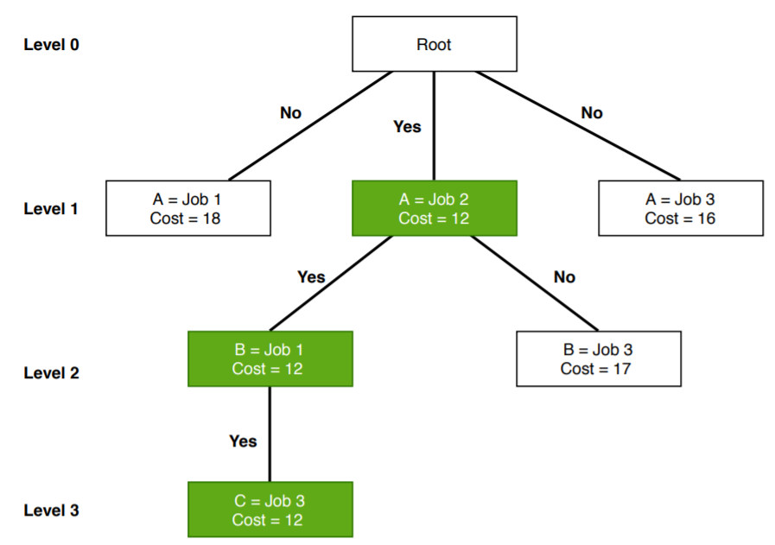
Branch and bound algorithm
Branch and bound algorithms are used to find the optimal solution for combinatory, discrete, and general mathematical optimization problems.
 | Job 1 | Job 2 | Job 3
A | 9 | 3 | 4
B | 7 | 8 | 4
C | 10 | 5 | 2

Slide 12

Questions??

